Slide 1
INTER PROCESS COMMUNICATION

Slide 2
What is Inter Process Communication?
In general, Inter Process Communication is a type of mechanism usually provided by the operating system (or OS). The main aim or goal of this mechanism is to provide communications in between several processes. In short, the intercommunication allows a process letting another process know that some event has occurred.

Slide 3
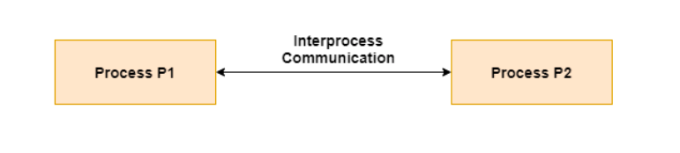
Definition
"Inter-process communication is used for exchanging useful information between numerous threads in one or more processes (or programs).“
Interprocess communication is the mechanism provided by the operating system that allows processes to communicate with each other. This communication could involve a process letting another process know that some event has occurred or the transferring of data from one process to another.

Slide 4
Why we need inter-process communication?
There are numerous reasons to use inter-process communication for sharing the data. Here are some of the most important reasons that are given below:
It helps to speed up modularity
Computational
Privilege separation
Convenience
Helps operating systems to communicate with each other and synchronize their actions as well.

Slide 5
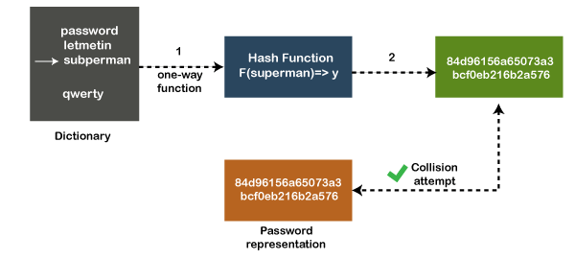
Architecture of Inter-process Communication

Slide 6
Role of Synchronization in Inter Process Communication
It is one of the essential parts of inter-process communication. Typically, this is provided by inter-process communication control mechanisms, but sometimes it can also be controlled by communication processes.
These are the following methods that used to provide the synchronization:
Mutual Exclusion
Semaphore

Slide 7
Mutual Exclusion
It is generally required that only one process thread can enter the critical section at a time. This also helps in synchronization and creates a stable state to avoid the race condition.

Slide 8
Semaphore
Semaphore is a type of variable that usually controls the access to the shared resources by several processes. Semaphore is further divided into two types which are as follows:
Binary Semaphore: synchronization mechanisms that have integer values that range from 0 (zero) to 1 (one). As a result, this type of semaphore gives a single point of access to a key portion. It signifies that only one individual will have simultaneous access to the critical part.
Counting Semaphore: A counting semaphore refers to a semaphore with several counter values. The value can span a wide range of possibilities. It is a structure that consists of a variable known as a semaphore variable, which can accept more than two values, and a list of tasks or entities, which is nothing more than the process or thread.

Slide 9
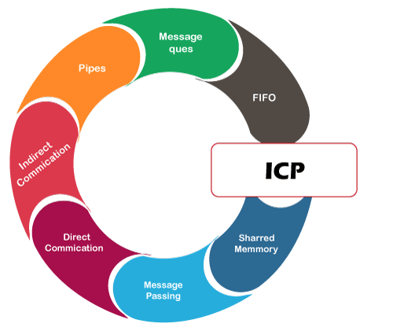
Approaches to Inter-process Communication
We will now discuss some different approaches to inter-process communication which are as follows:

Slide 10
Pipes
The pipe is a type of data channel that is unidirectional in nature. It means that the data in this type of data channel can be moved in only a single direction at a time. Still, one can use two-channel of this type, so that he can able to send and receive data in two processes. Typically, it uses the standard methods for input and output. These pipes are used in all types of POSIX systems and in different versions of window operating systems as well.

Slide 11
Shared Memory
It can be referred to as a type of memory that can be used or accessed by multiple processes simultaneously. It is primarily used so that the processes can communicate with each other. Therefore the shared memory is used by almost all POSIX and Windows operating systems as well.

Slide 12
Message Queue
In general, several different messages are allowed to read and write the data to the message queue. In the message queue, the messages are stored or stay in the queue unless their recipients retrieve them. In short, we can also say that the message queue is very helpful in inter-process communication and used by all operating systems.

Slide 13
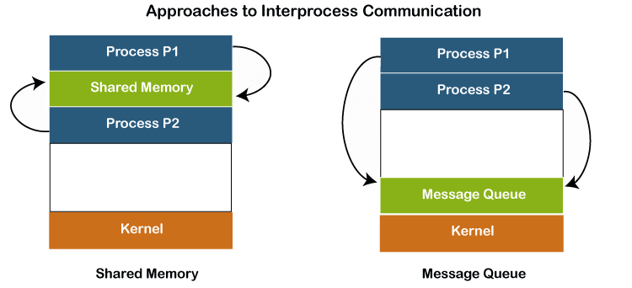
To understand the concept of Message queue and Shared memory in more detail, let's take a look at its diagram given below:

Slide 14
Message Passing:-
It is a type of mechanism that allows processes to synchronize and communicate with each other. However, by using the message passing, the processes can communicate with each other without restoring the hared variables.
Usually, the inter-process communication mechanism provides two operations that are as follows:
send (message)
received (message)

Slide 15
Direct Communication:-
In this type of communication process, usually, a link is created or established between two communicating processes. However, in every pair of communicating processes, only one link can exist.

Slide 16
Indirect Communication
Indirect communication can only exist or be established when processes share a common mailbox, and each pair of these processes shares multiple communication links. These shared links can be unidirectional or bi-directional.

Slide 17
FIFO
It is a type of general communication between two unrelated processes. It can also be considered as full-duplex, which means that one process can communicate with another process and vice versa.

Slide 18
Some other different approaches
Socket:-
It acts as a type of endpoint for receiving or sending the data in a network. It is correct for data sent between processes on the same computer or data sent between different computers on the same network. Hence, it used by several types of operating systems.
File:-
A file is a type of data record or a document stored on the disk and can be acquired on demand by the file server. Another most important thing is that several processes can access that file as required or needed.

Slide 19
Some other different approaches
Signal:-
As its name implies, they are a type of signal used in inter-process communication minimally. Typically, they are the messages of systems that are sent by one process to another. Therefore, they are not used for sending data but for remote commands between multiple processes.
Usually, they are not used to send the data but to remote commands in between several processes.

Slide 20
Thank You

